Slide 1
Policy Voter
PJ Ofremu, James Leonard, Chris Chheang, Jason Chong

Slide 2
Purpose
A voting system an organization can use as approval process to adopt new policies
Users are able to write new policies to vote on
Notify users when new policies are available to vote on
Notify users to remind them of current policies being voted on
Store historical voting data
Created for cross platform mobile environment (IOS and Android)
Notes:
Any user of the app will be able to create new policies and vote on current policies

Slide 3
Tech Stack
Flutter SDK
ExpressJS Backend Server
Cloud Firestore Database
Firebase Cloud Messaging
Notes:
Firebase cloud messaging is for the notifications
Firestore is also a DB option

Slide 4
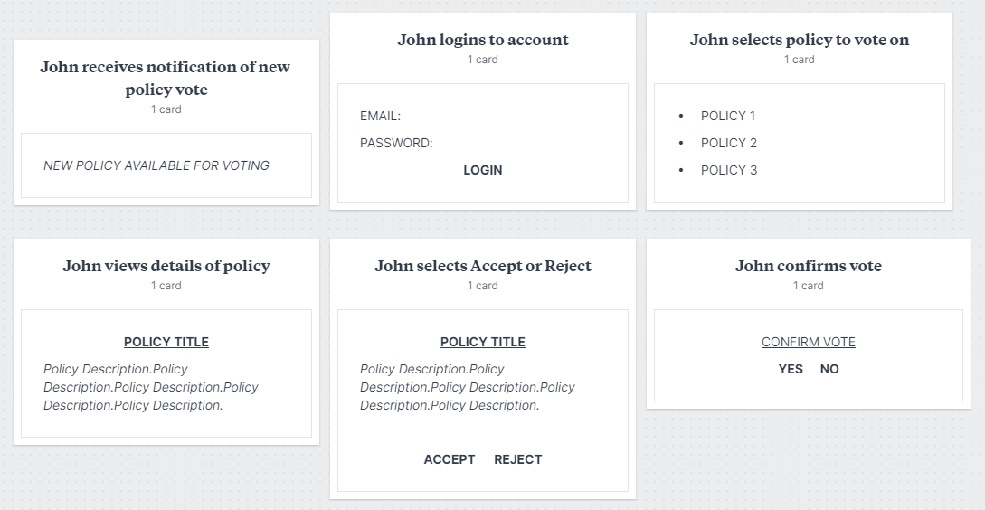
Voter Storyboard
Notes:
John is a member of a committee board. He wants to be able to vote on policies from his mobile device.
John is notified of a new policy to vote on from the app. He opens the mobile app and is prompted to login with his username and password. The titles of the current policies to vote on are listed on the display.
John selects the policy he wants to vote on and the details of the policy are displayed on the screen. At the bottom of the screen there are two options for John to choose from, “Accept” and “Reject”.
John selects an option and is prompted to confirm his choice. If he chooses “No” he is returned to the description of the policy and allowed to change his vote. If he chooses “Yes” his vote is submitted and counted towards the total for that policy. The list of policies for him to vote on are then updated and he is able to choose another policy to vote on

Slide 5
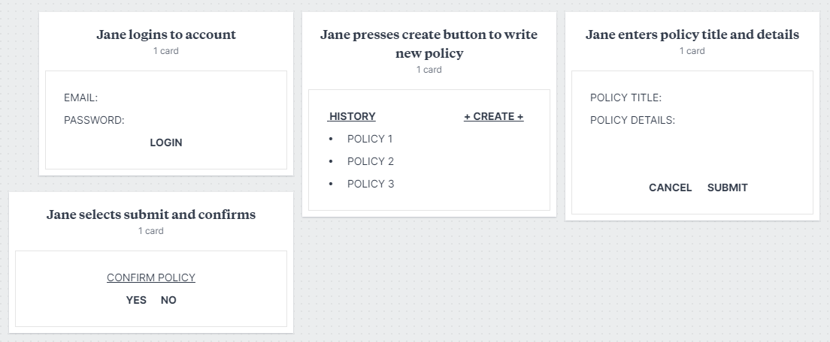
Policy Writer Storyboard
Notes:
Jane is a member of a committee board. She wants to be able to write new policies for voting on her mobile device.
She opens the mobile app and is prompted to login with his username and password. The titles of the current policies to vote on are listed on the display. She clicks the create button to start the creation of a new policy for voting.
She enters the title and description of the policy in their respective input fields. She clicks the “Submit” button is prompted to confirm the submission. If she clicks “No” she returned to the previous screen to make any changes she wants. If she clicks “Yes” voting for that policy is begins.
The policy is stored in the database and all committee members are notified of the new policy voting.

Slide 6
